Slide 1
Chatbot System
BY
Shubham Patel - 21162171024

Slide 2
SRS FORMAT
01
02
03
04
Introduction
Overall Description
Requirement
Specifications
Diagrams

Slide 3
INTRODUCTION
Purpose
Scope
Glossary
Overview

Slide 4
PURPOSE
A chatbot is a computer program that is designed to simulate conversation with human users, especially over the Internet.
Chatbots are often used in customer service to answer frequently asked questions, or to help customers complete a task.
Chatbots can also be used for entertainment, such as creating chatbots that can tell jokes or play games with users.
Some chatbots are designed to be very human-like in their conversation, while others are more straightforward and simply provide information.
Chatbots are usually accessed through a chat interface, such as a messaging app, a website, or a mobile app..

Slide 5
SCOPE
Some chatbots are designed to handle a specific task, such as answering questions about a particular topic or helping users make a purchase.
Other chatbots are more general-purpose and can handle a wide range of tasks and conversations.
The scope of a chatbot is ultimately determined by the goals of its creators and the capabilities of the underlying technology.

Slide 6
GLOSSARY
Artificial intelligence (AI) - The branch of computer science that aims to create intelligent machines that can think and act like humans.
Natural language processing (NLP) - The ability of a computer to understand, interpret, and generate human language.
Chatbot - A computer program designed to simulate conversation with human users, especially over the Internet.
Chat interface - A user interface that allows users to communicate with a chatbot, typically through a messaging app, website, or mobile app.
Dialog flow - The sequence of interactions that take place between a user and a chatbot during a conversation.

Slide 7
GLOSSARY
6. Entity - A specific piece of information that a chatbot can recognize and extract from a user's message.
7. Knowledge base - A database of information that a chatbot can use to answer questions or provide information to users.
8. Machine learning - A type of artificial intelligence that enables computers to learn and adapt to new data without being explicitly programmed.

Slide 8
OVERVIEW
A chatbot is a computer program designed to simulate conversation with human users, especially over the Internet.
Chatbots can be used in a variety of contexts, such as customer service, marketing, or entertainment.
They can be found on websites, messaging apps, and even as part of virtual assistants on smartphones.

Slide 9
OVERVIEW
There are two main types of chatbots: rule-based and artificial intelligence-based.
1. Rule-based chatbots are programmed to follow a specific set of rules to respond to user input. These chatbots can handle simple queries and provide basic information, but they are not able to understand or respond to more complex questions.
2.Overall, chatbots can be a useful tool for businesses or organizations looking to improve customer service, generate leads, or engage with users in a more interactive way.
Artificial intelligence-based chatbots, on the other hand, use machine learning algorithms to understand and respond to user input. These chatbots can understand and interpret more complex queries and can generate responses that are more natural and human-like.

Slide 10
OVERALL DESCRIPTION
Problem Statement
Existing System
Proposed System
Product Functions
User’s Characteristics
Constraints
Assumption And Dependencies

Slide 11
PROBLEM STATMENT
Many companies today are still struggling with engaging their audience, providing 24/7 customer service, and streamlining their sales processes.
As a result, businesses are losing potential customers and revenue.
A chatbot could be an effective solution for these issues by providing around-the-clock customer service, lead generation and qualification, and automating sales processes.
The goal of this project is to develop a chatbot that can understand natural language input, answer questions and perform tasks.
And also providing accurate and personalized responses to customer inquiries, increasing customer satisfaction and sales revenue.

Slide 12
EXISTING SYSTEM
The existing system consists of either not up-to-the-mark chatbots or workers with paid jobs for this position.
This leads to higher resource cost over just subscribing to a chatbot system for over the surface interaction with customers.

Slide 13
PROPOSED SYSTEM
We propose the use our chatbot system for every basic interactions that can be integrated with any business.
Any and all inquiries regarding prices, refundability, availability(of say, a 'Product' for example) or any other cursory topics can be easily integrated into and handled by the system.
For all the 'Business-Specific' questions which may only be known to a certain position of employees and above, the task can be transferred over to an employee.

Slide 14
PRODUCT FUNCTIONS
Natural Language Processing (NLP) to understand and respond to user input in a human-like manner.
Integration with external data sources and APIs to provide relevant information to users.
Ability to handle multiple languages and dialects.
User engagement and conversation flow management to guide users through a task or conversation.
Ability to handle a wide range of user inquiries, from simple questions to more complex interactions.
Customizable responses and the ability to handle different types of user data.
Advanced analytics and reporting to track performance and improve the chatbot's effectiveness over time.
Self-learning capability to improve the chatbot's understanding of user input over time.

Slide 15
USER’S CHARACTERISTICS
User’s Requirements
User’s Educational Level
User’s Technical Expertise

Slide 16
USER'S REQUIRMENTS
The ability to handle a high volume of customer inquiries, providing 24/7 availability and reducing the need for human customer service representatives.
Integration with existing systems and databases, such as customer information and order history, to provide personalized and accurate responses to customers.
The ability to handle multiple languages and dialects to serve a global customer base.
The ability to handle high traffic and multiple users simultaneously with inquiries including frequently asked questions and more complex issues.
Compliance with data protection and security regulations.
The ability to guide customers through the purchasing process, upselling or cross-selling products, and increasing the conversion rates.

Slide 17
USER'S EDUCATIONAL LEVEL
The chatbot system should be designed to be user-friendly and easy to navigate for users of all educational levels.
The interface should be intuitive and the language used should be simple and easy to understand, avoiding complex technical jargon or terminology.
The chatbot should be able to provide step-by-step instructions and guidance for completing tasks, such as making a purchase or troubleshooting an issue, to ensure that all users can successfully interact with the system.
The chatbot should be designed to be flexible and adaptable to the users' needs, and should be able to adjust its responses based on the user's educational level, where possible.

Slide 18
USER'S TECHNICAL EXPERTISE
We would not assume any particular level of technical expertise for our users.
Additionally, the chatbot should have a self-help feature, such as a FAQ section, to provide solutions to common problems without the need for human assistance.

Slide 19
CONSTRAINTS
Technical constraints such as hardware and software limitations, which can affect the chatbot's performance and scalability.
Time and budget constraints that may limit the scope and complexity of the chatbot's capabilities.
Data privacy and security constraints that may limit the types of information that the chatbot can collect and store.
Legal and regulatory constraints that may limit the chatbot's ability to operate in certain jurisdictions or industries.
Language and dialect constraints that may limit the chatbot's ability to understand and respond to user input in certain languages or dialects.
Accessibility constraints that may limit the chatbot's ability to serve users with disabilities or accessibility needs.
Performance constraints such as response time and accuracy that may affect the chatbot's usability and user satisfaction

Slide 20
ASSUMPTION AND DEPENDENCIES
Dependence on the availability and reliability of internet and network connections for the chatbot to function.
Dependence on the availability and accuracy of external data sources, such as databases and APIs, which the chatbot relies on to provide relevant information to users.
Dependence on the availability of the necessary personnel, such as data scientists, to maintain and update the chatbot.
Assumptions about the device and platform compatibility, such as browsers, mobile and desktop operating systems, and screen sizes, which the chatbot needs to support.
Assumptions about the user's technical expertise and familiarity with the chatbot's interface and functionality.
Assumptions about the user's language and dialect, which the chatbot needs to support.

Slide 21
REQUIREMENT SPECIFICATION
Functional Requirements
Non Functional Requirements

Slide 22
FUNCTIONAL REQUIREMENTS
Performance Requirements
Design Constraints
Hardware Requirements
Software Requirements
Other Requirements

Slide 23
PERFORMANCE REQUIREMENTS
Response time: The chatbot should be able to respond to user inquiries within an acceptable time frame, typically a few seconds to a few minutes, depending on the complexity of the inquiry.
Accuracy: The chatbot should be able to provide accurate and relevant responses to user inquiries, with a high degree of confidence.
Scalability: The chatbot should be able to handle a high volume of user inquiries and support a large number of users simultaneously.
Security: The chatbot should be able to protect user data and ensure compliance with data protection and security regulations.
Customizability: The chatbot should be able to adapt and tailor its responses based on the user's input, context, and history.

Slide 24
DESIGN CONSTRAINTS
User interface constraints, such as the availability of different modes of interaction (text, voice, touch) and the availability of different input methods (keyboard, touch-screen, speech).
Accessibility constraints that may limit the chatbot's ability to serve users with disabilities or accessibility needs.
Architecture constraints may lead to incomplete reach as should have been projected.

Slide 25
HARDWARE REQUIREMENTS
CPU: The chatbot should have sufficient processing power to handle natural language processing (NLP) and other complex tasks.
Memory: The chatbot should have sufficient memory to store and access the knowledge base and other data.
Storage: The chatbot should have sufficient storage capacity to store the knowledge base, historical data, and other information.
Connectivity: The chatbot should have sufficient network connectivity to communicate with external systems and data sources.
Power consumption: The chatbot's hardware should have low power consumption to minimize the cost of operation.
Durability: The chatbot's hardware should be durable to operate in different environments.
Portability: The chatbot's hardware should be portable if the chatbot needs to be deployed in different locations.

Slide 26
SOFTWARE REQUIREMENTS
Natural Language Processing (NLP) capability: The chatbot should be able to understand and respond to user input in a human-like manner.
Integration with external data sources and APIs: The chatbot should be able to integrate with external systems and data sources to provide relevant information to users.
Multi-language support: The chatbot should be able to handle multiple languages and dialects.
Conversation flow management and Customizable responses: The chatbot should be able to guide users through a task or conversation and should be able to handle different types of user data and provide customizable responses.
Self-learning capability: The chatbot should be able to improve its understanding of user input over time.
Compatibility: The chatbot should be compatible with different devices and platforms such as browsers, mobile, and desktop operating systems, and screen sizes.

Slide 27
OTHER REQUIREMENTS
Data management:
Users: Company Employees, DBAdmins
Result: The chatbot should have the capability to manage and store user data in a secure and compliant manner.
Human fallback:
Users: End-User Customers
Result: The chatbot should have the capability to escalate a conversation to a human agent if it is unable to handle the user's request.
Compliance:
Users: Company Employees
Result: The chatbot should comply with relevant industry regulations and standards, such as GDPR, HIPAA, and SOC2.

Slide 28
OTHER REQUIREMENTS
Maintenance and updates:
Users: Developers
Result: The chatbot should have a mechanism for regular maintenance and updates to improve its performance and add new features.
Monitoring and reporting:
Users: Company Employees
Result: The chatbot should have the capability to monitor and report on its performance, including metrics such as response time and accuracy.

Slide 29
NON FUNCTIONAL REQUIREMENTS
Scalability: The chatbot should be able to handle a high volume of user inquiries and support a large number of users simultaneously.
Maintainability: The chatbot should be designed to be easy to maintain and update, with minimal downtime or disruption to users.
Portability: The chatbot should be able to run on different hardware and software platforms.
Extensibility: The chatbot should be designed to allow for future expansion and growth of its capabilities.
Testability: The chatbot should be designed to be easily testable, with clear and measurable performance metrics.

Slide 30
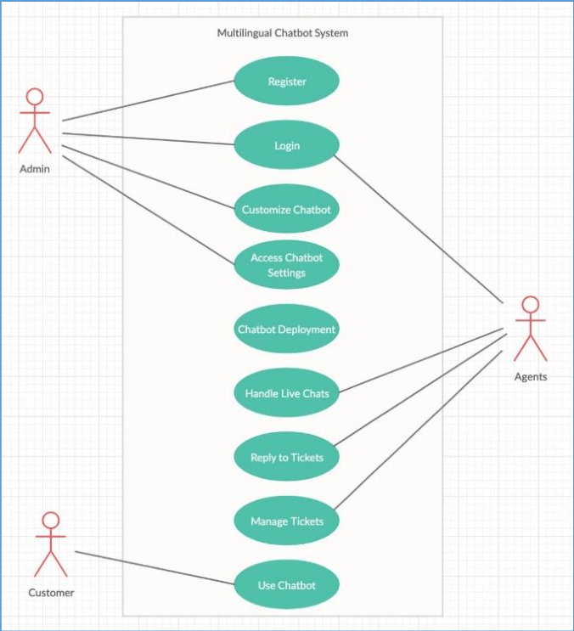
DIAGRAMS
Use Case Diagram

Slide 31
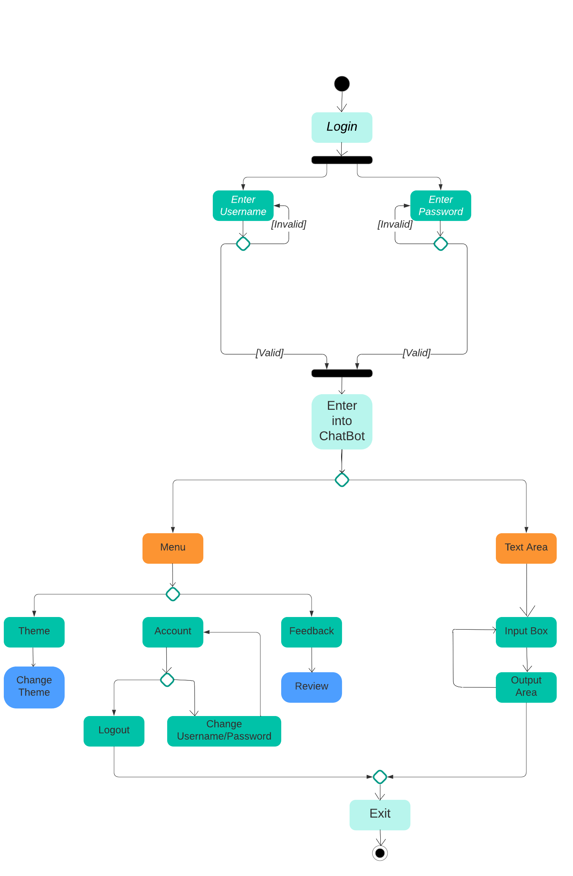
DIAGRAMS
Activity Diagram

Slide 32
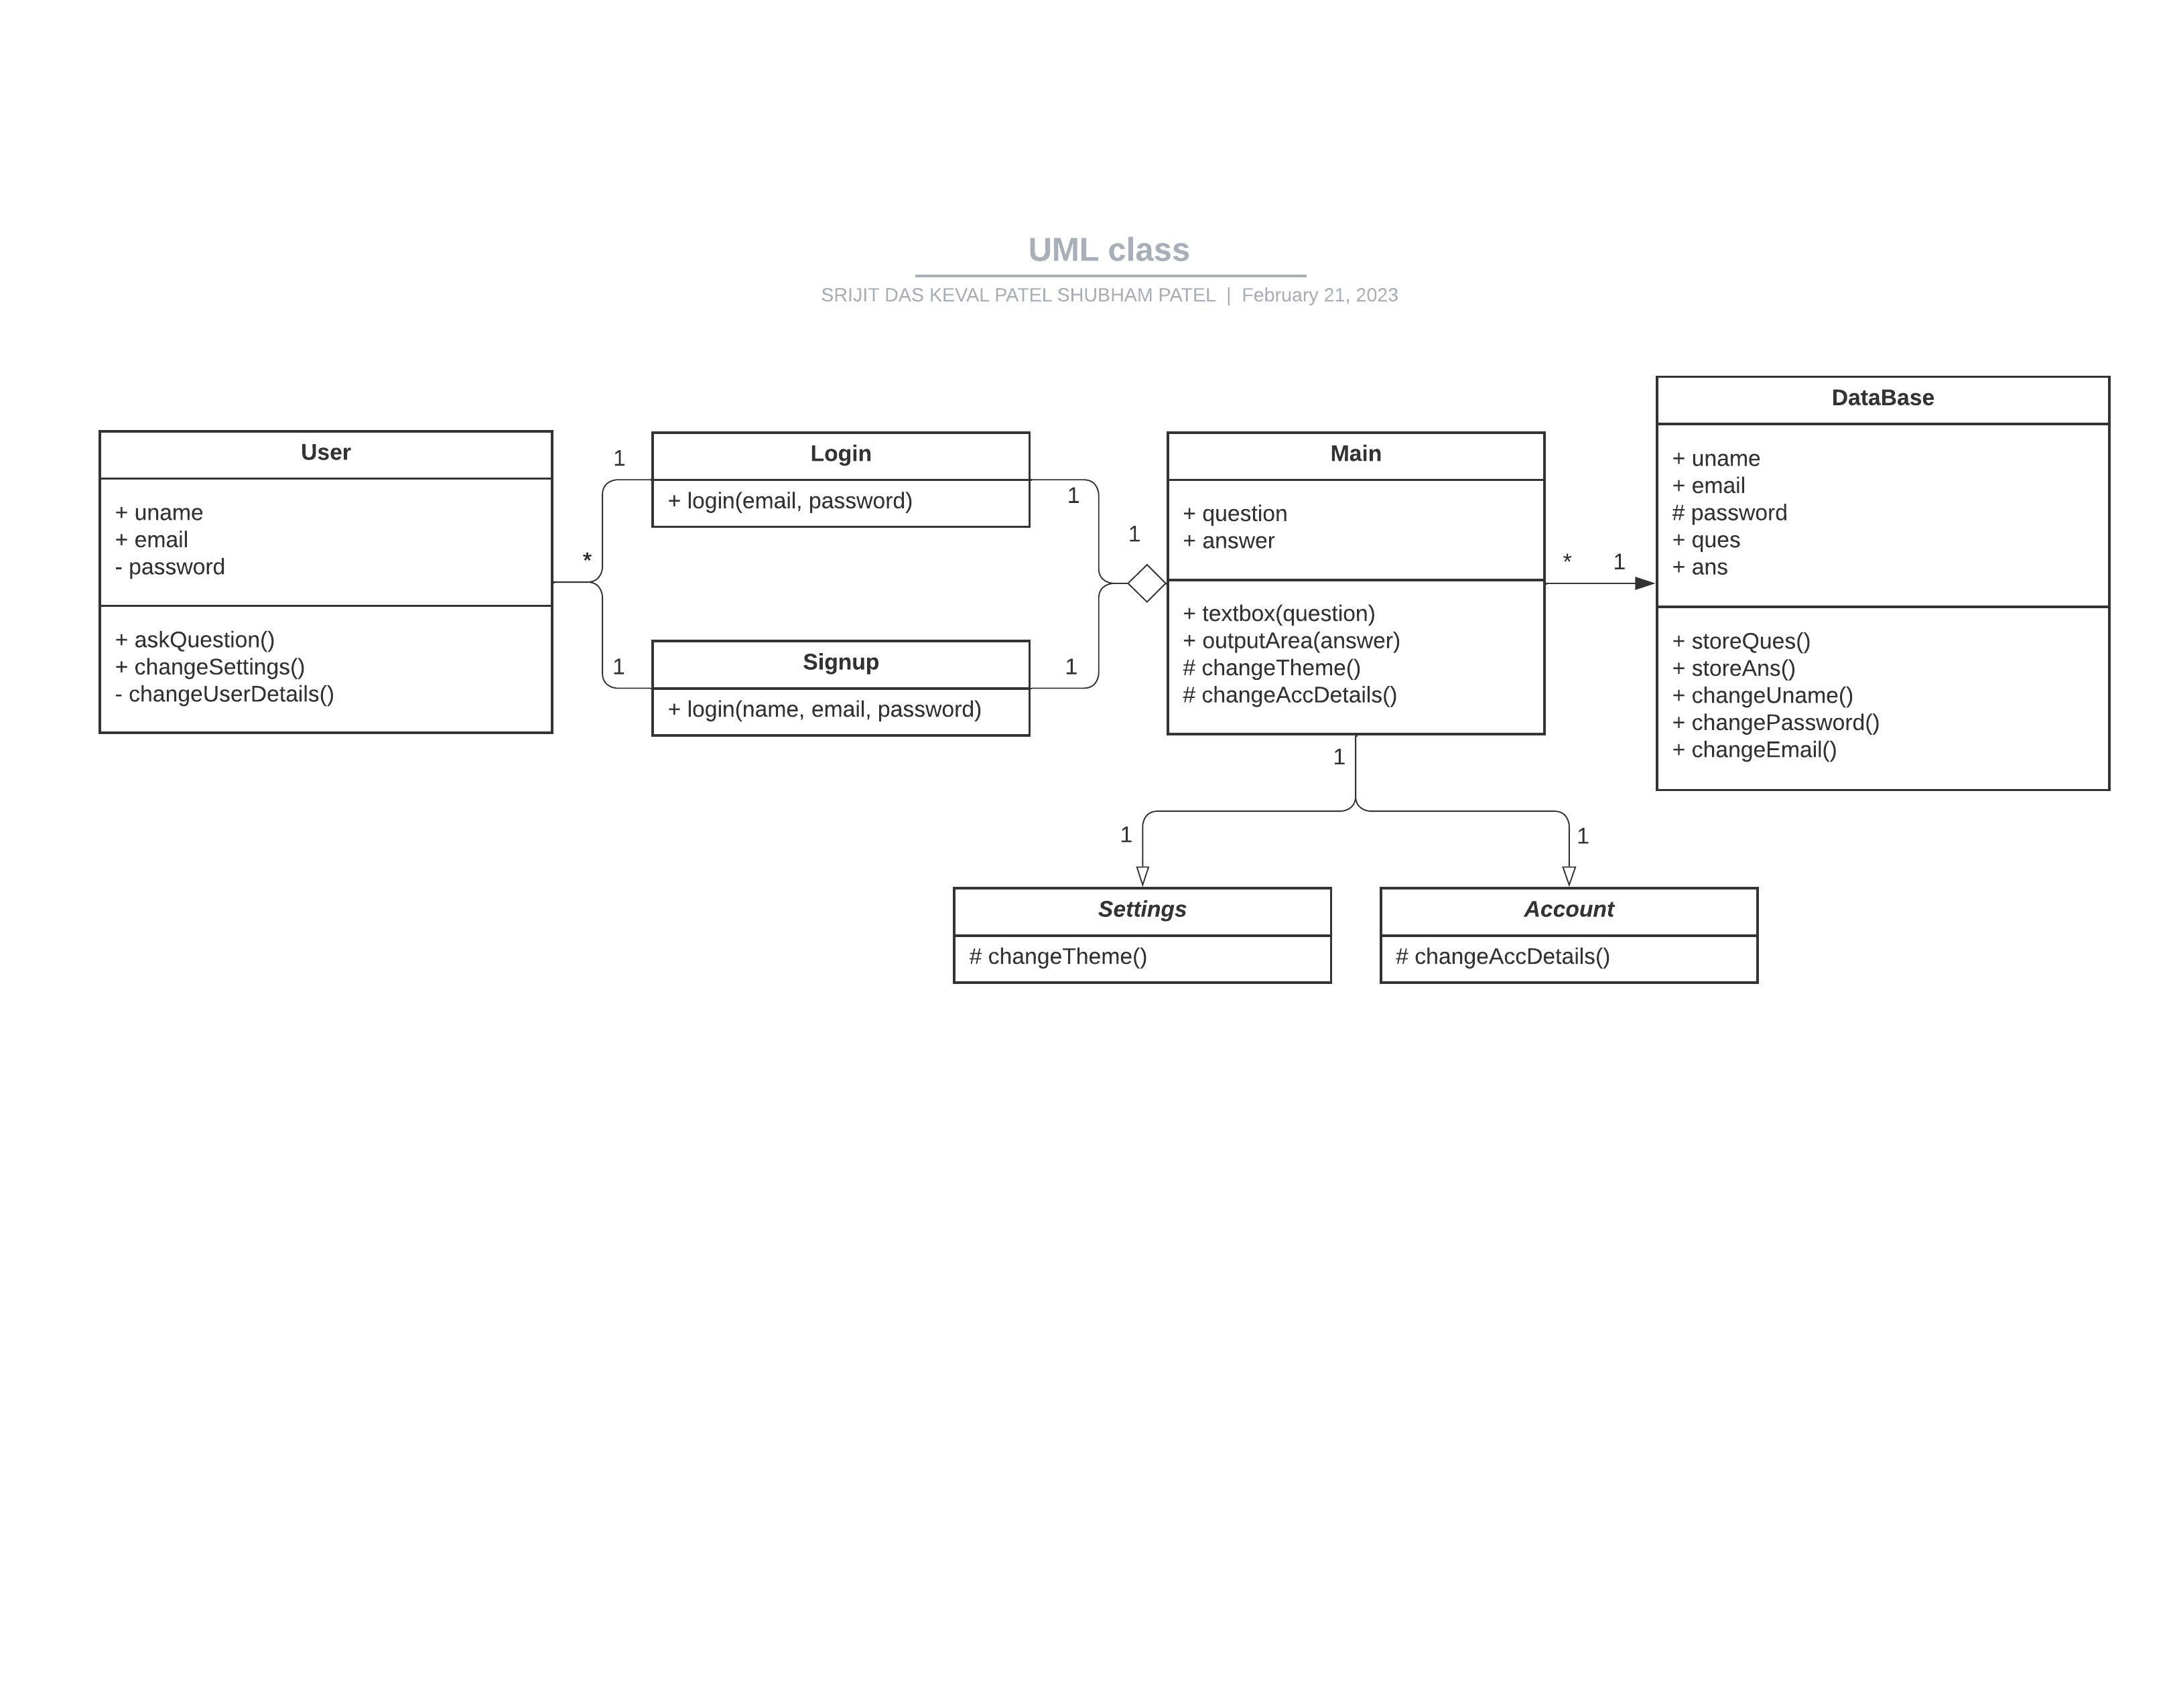
DIAGRAMS
Class Diagram

Slide 33
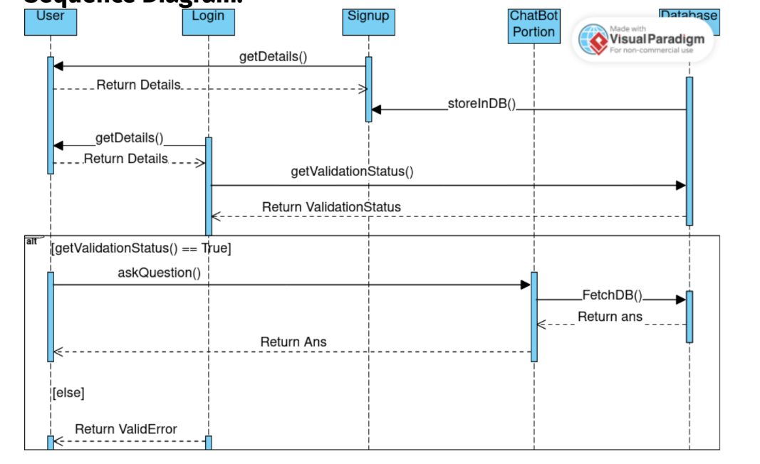
DIAGRAMS
Sequence Diagram

Slide 34
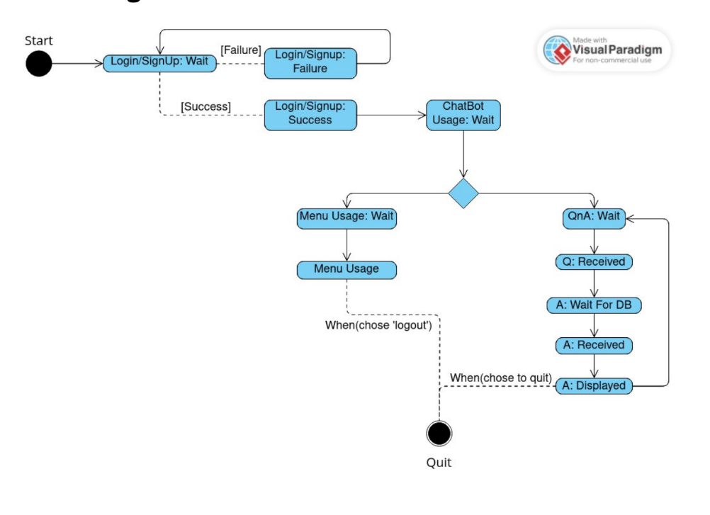
DIAGRAMS
State Diagram

Slide 35
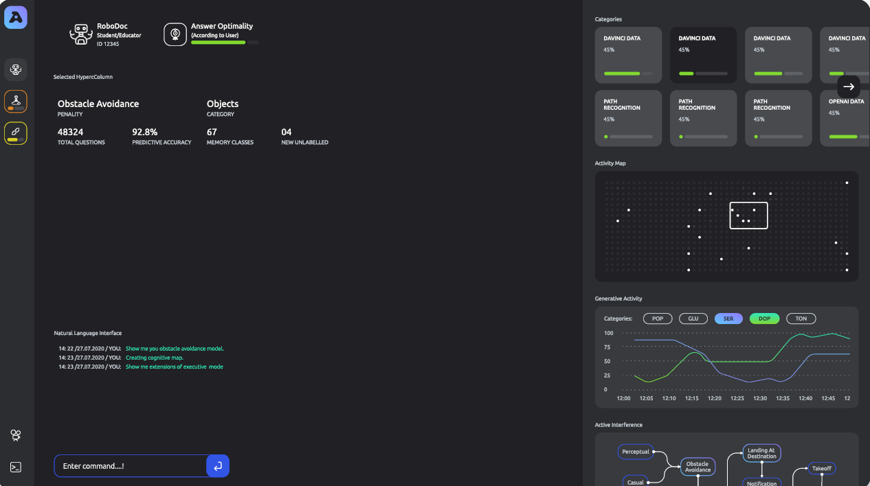
WireFrame

Slide 36
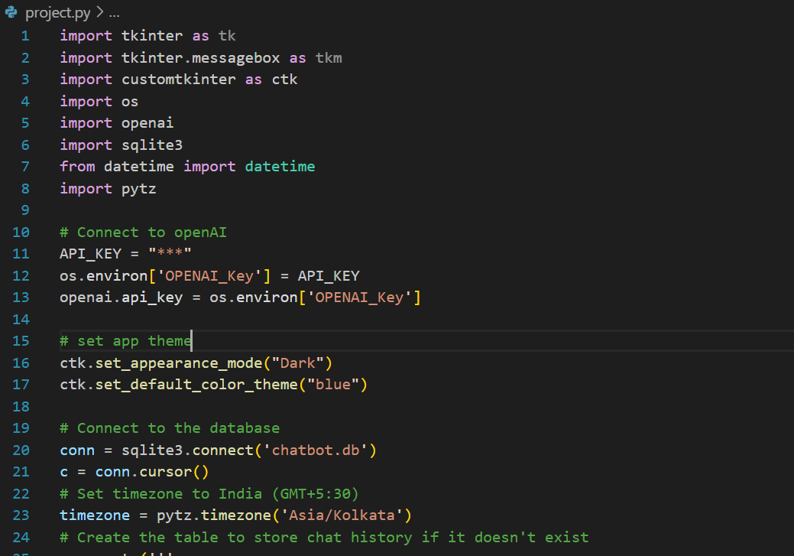
Code

Slide 37
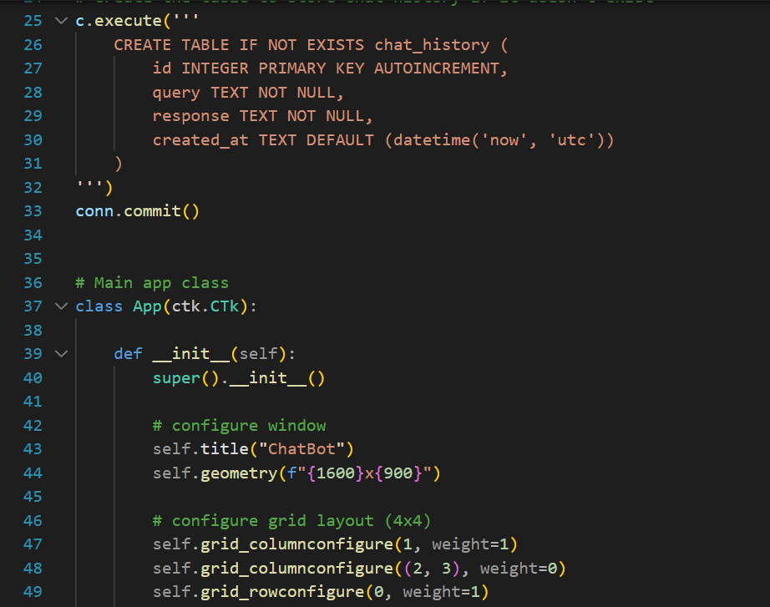
Code

Slide 38
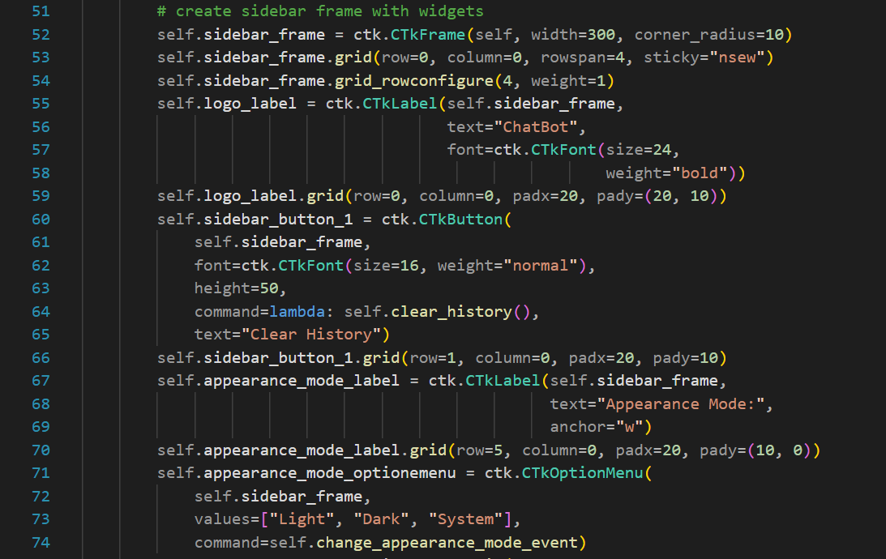
Code

Slide 39
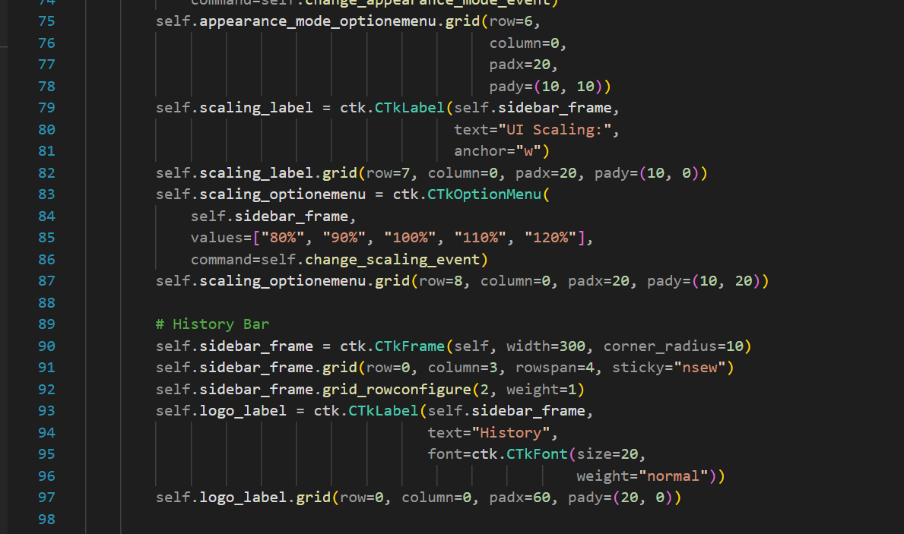
Code

Slide 40
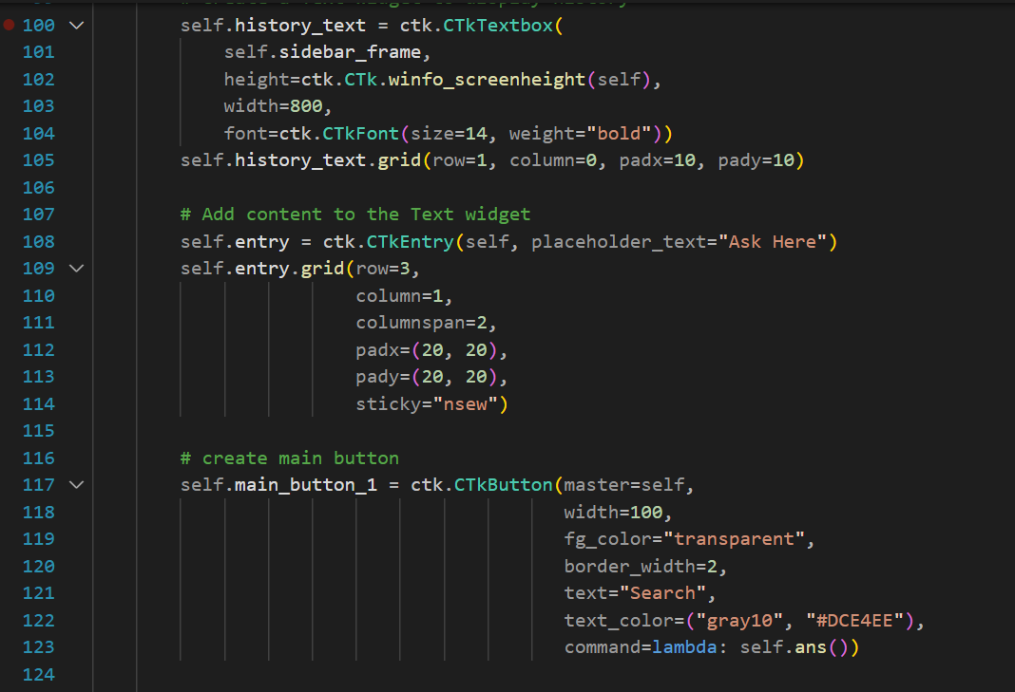
Code

Slide 41
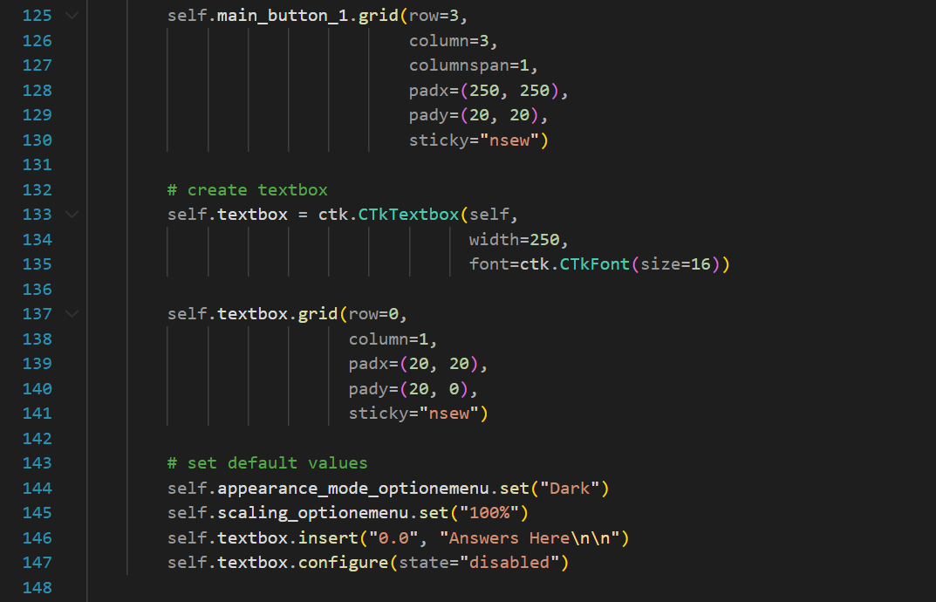
Code

Slide 42
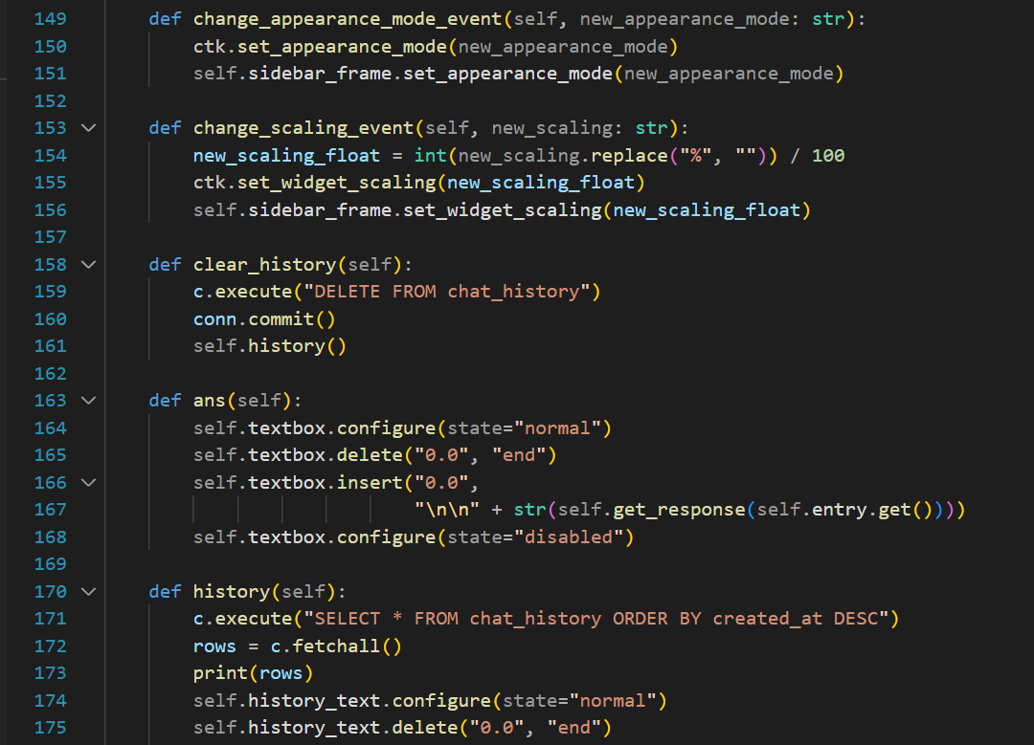
Code

Slide 43
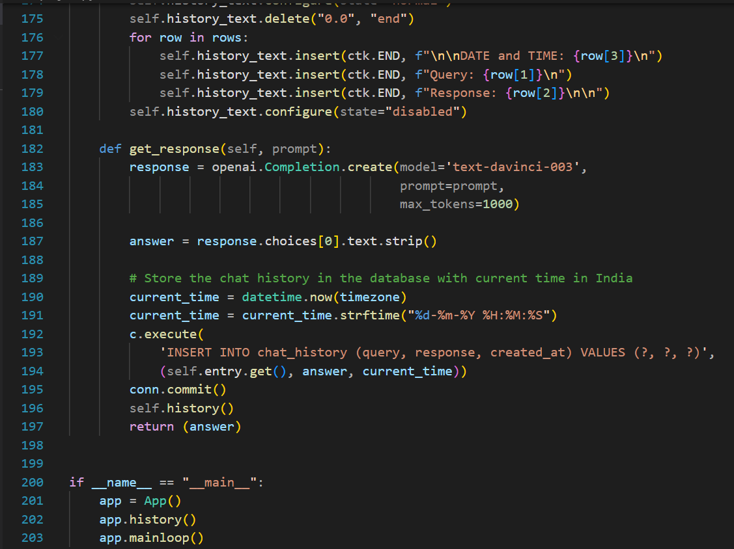
Code

Slide 44
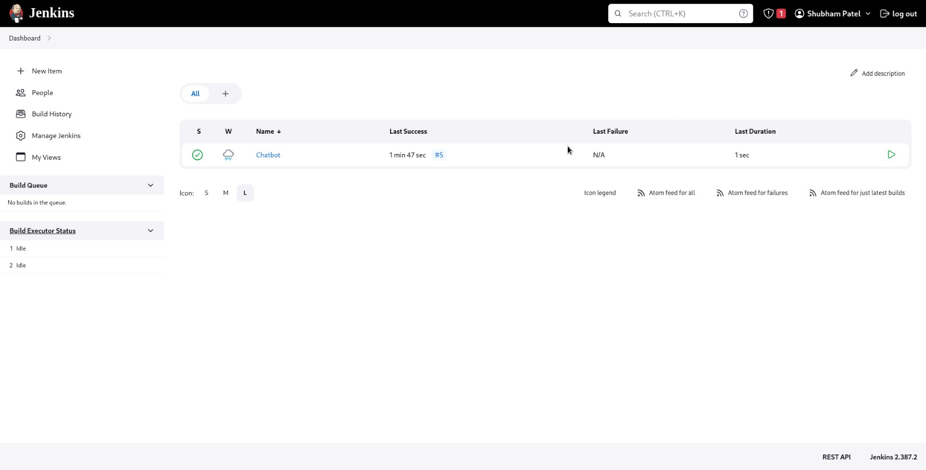
Testing

Slide 45
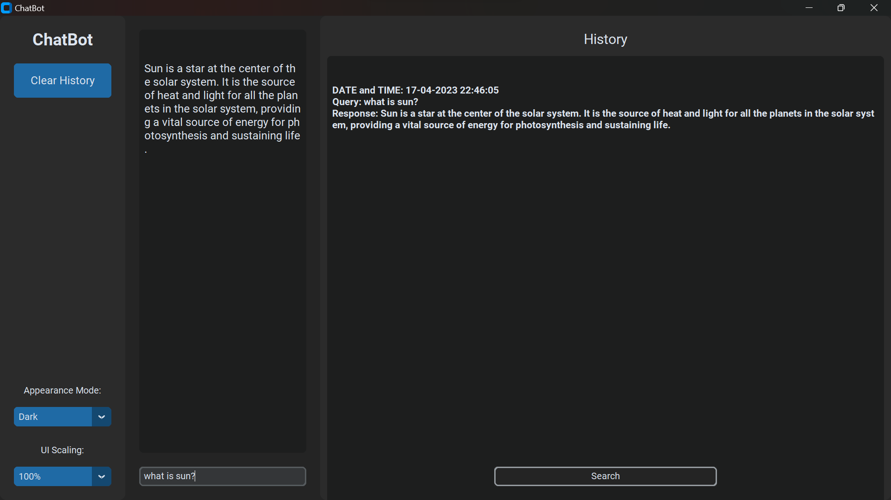
Output

